Slide 1
US Dept of Transportation Overview of Federal-Aid Program
3 February 2015

Slide 2
Agenda
Overview of USDOT’s Programs in Puerto Rico
Show Me the Money !
Opportunities

Slide 3
US Department of Transportation
Mission: Ensure a fast, safe, efficient, accessible and convenient transportation system that meets vital national interests and enhances quality of life
Agency
OST
FAA
FHWA
FTA
NHTSA
FMCSA
Others
PR Government
Governor’s Office
Airports Authority
DTOP, PRHTA, Municipios
DTOP, AMA/ATI, Ports Authority
Traffic Safety Commission
Public Service Commission
None
Activity in PR
Liaison with Governor’s office
Airports and Air Traffic Control
Highways and Bridges
Public Transportation
Safety Improvements
Commercial Vehicle Safety
None

Slide 4
Show Me The Money
Highway Trust Fund (HTF)
Alabama
Public Transportation Projects
Fuel Tax
Other Tax
Texas
Others
Puerto Rico Department of Transportation & Public Works
(STIP)
5 Year Plan
US Congress
Highway Construction and Consultant Projects
FHWA PR Division

Slide 5
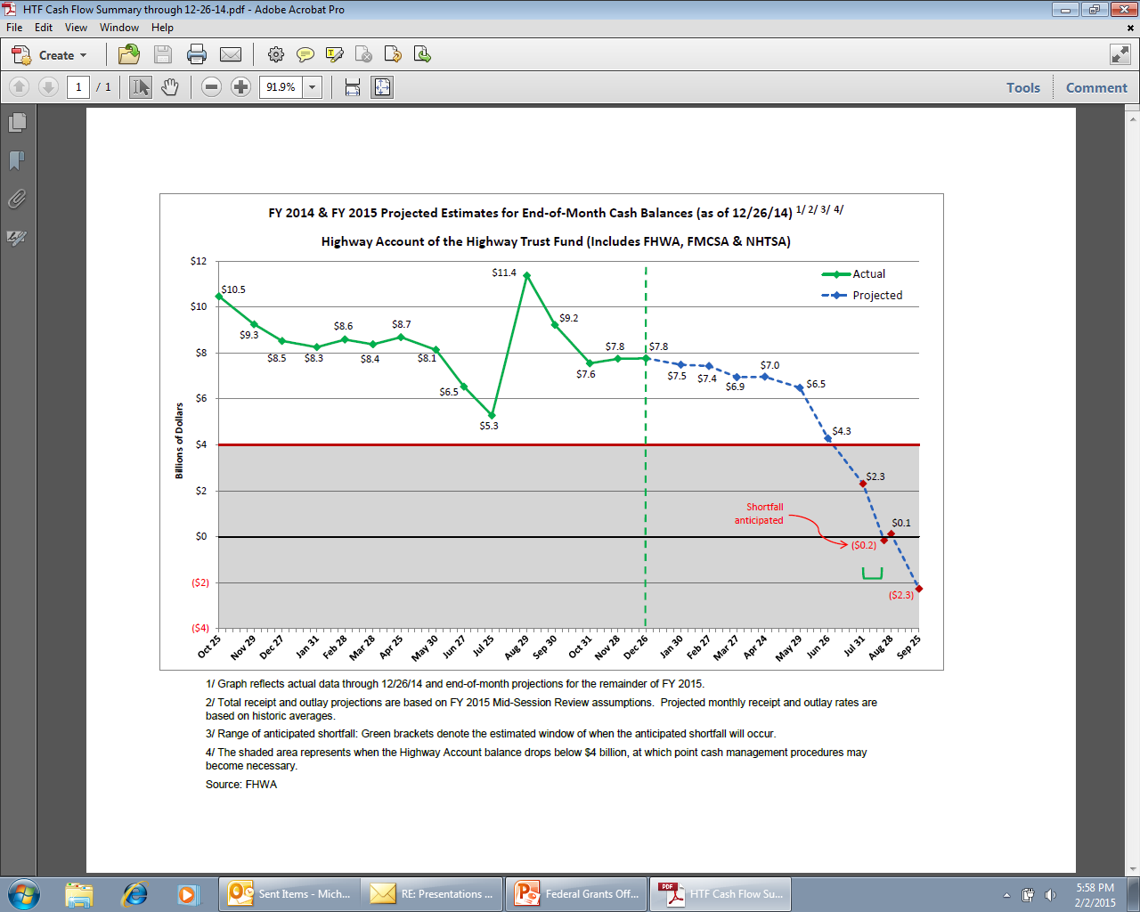

Slide 6
Federal Aid Funding in Puerto Rico
Puerto Rico Program
Programs and Projects
$150M per year
Penalties = Approx $18M per year
Public Procurement
Grant Program with Reimbursement
200 Active Highway Projects
STIP
Highway Trust Fund (HTF)
President’s Budget
New Transportation Legislation
US Virgin Islands Program
$15M per year
Public Procurement

Slide 7
Federal Goals/Requirements
Compliance
Planning/Environment
Competition
Transparency
Civil Rights
Minimum salary
USDOT Goals: Safety, Mobility, etc
Every Day Counts/Job Creation/Economic Growth

Slide 8
Opportunities
Core USDOT Programs: Federal-Aid, Federal Transit, Airports Improvements, etc
New Federal Legislation, 30 Year Transportation Vision
TIGER Grants
TIFIA and RIFF Loans
Private Sector Participation
Emergency Response
Technical Assistance
Others (e.g. Connected Vehicles)

Slide 9
Closing Comments
USDOT has major programs in Puerto Rico
Federal-Aid Program is a Grant Program and projects are programmed by PRTHA
Changes coming: New Legislation/HTF
Opportunities exist for contractors and consultants

